Slide 1
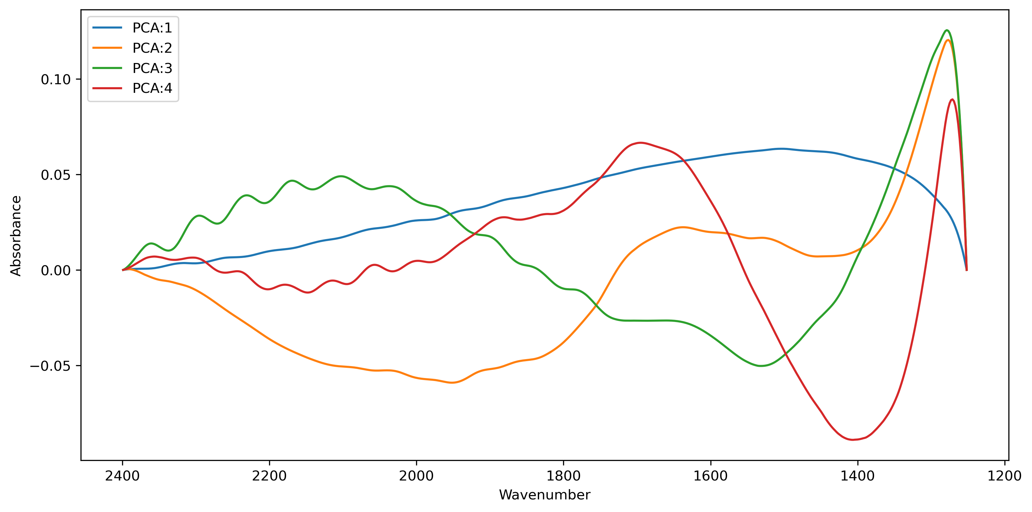
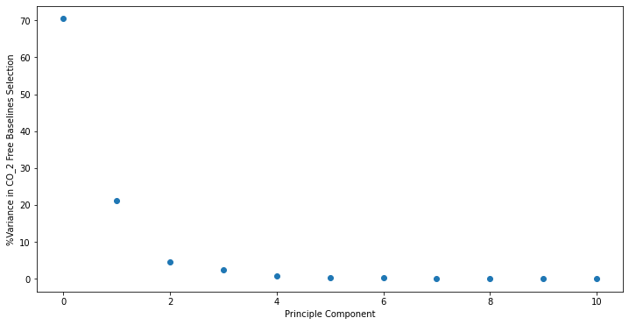
Baseline PCA vectors from all spectra including ones where water peak was removed.
(Currently implemented in MCMC code)
These are the ranges for the prior values for each PCA vector in the original data. We may need to scale these to our spectra. The input baseline spectra have all been scaled to a max and min range of 1. We may need to scale these multipliers to the range of the spectra given from the max – min.
 | PCA 1 | PCA 2 | PCA 3 | PCA 4
Max | 1.98 | 0.72 | 0.45 | 0.39
Min | -1.81 | -0.63 | -0.39 | -0.22

Slide 2
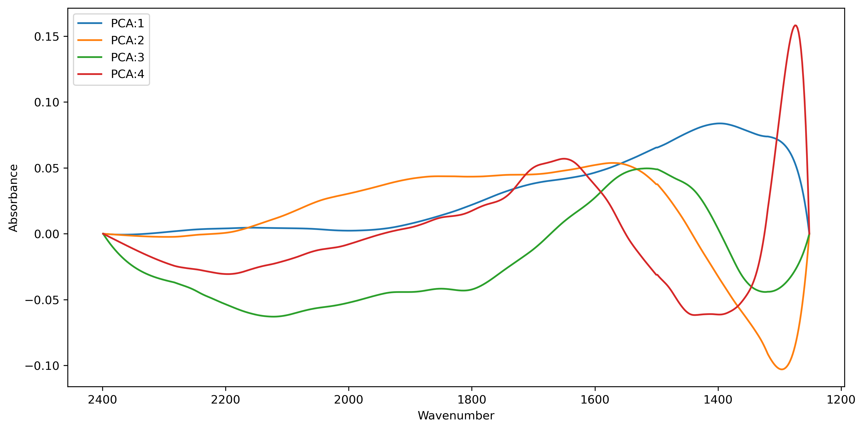
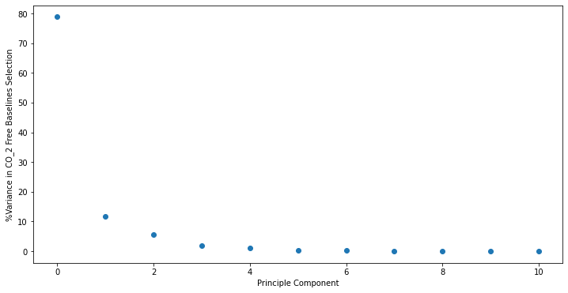
Baseline PCA vectors from rigorously smoothed H2O free spectra
These are created by fewer spectra that are more processed to remove interference fringes
PCA 1 looks worse but others might be better.
 | PCA 1 | PCA 2 | PCA 3 | PCA 4
Max | 2.81 | 0.88 | 0.65 | 0.3
Min | -1.01 | -0.82 | -0.61 | -0.2

Slide 3
Baseline PCA vectors from all spectra including ones where water peak was removed.
(Currently implemented in MCMC code)
Baseline PCA vectors from rigorously smoothed H2O free spectra

